Slide 1
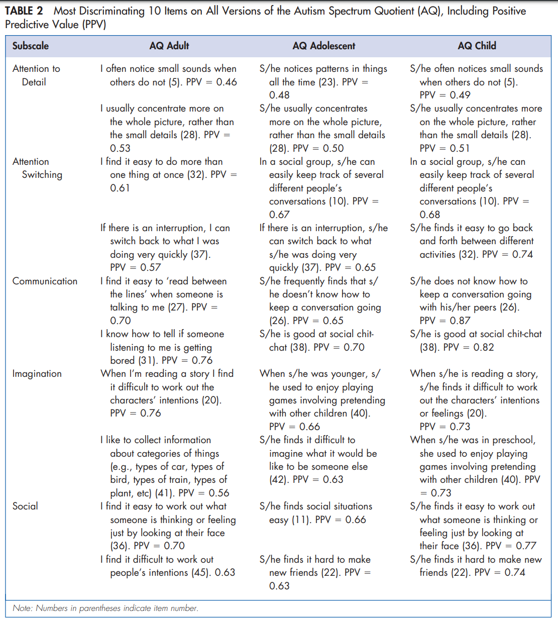
REFERENCE:
Allison C, Auyeung B and Baron-Cohen S. Toward brief ‘Red Flags’ for autism screening: the short Autism Spectrum Quotient and the short Quantitative Checklist for Autism in Toddlers in 1,000 cases and 3,000 controls. J Am Acad Child Adolesc Psychiatry 2012; 51(2): 202–212.

